Slide 1
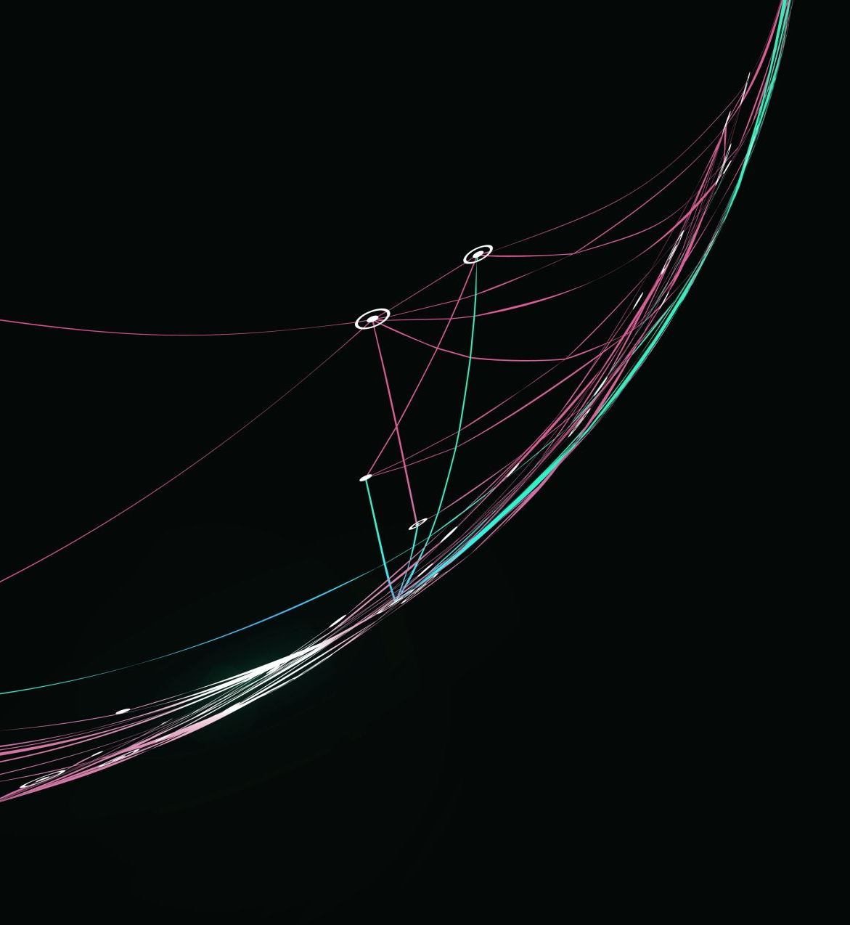
InvestIQ
By Team 02 Techno Stack

Slide 2
Agenda
Team Member Roles and Responsibilities
Problem Statement
Project Description
Personas
Technologies
Algorithms
Project Schedule – Cadence
Team Working Agreement
RetrospectiveGroup
Wikipage Link

Slide 3


Team Members
Ruchitha Reddy Kuthuru – Product Manager and Full Stack developer
Mahidhar Reddy Kandula – Machine learning Engineer

Slide 4


Team Members
Afrida Mehanaz Shaik– Machine Learning Engineer
Sharan Jagini – Backend Engineer and Tester

Slide 5


Team Members
Nadeem Hussain Shaik – Frontend Developer
Shrinidhi Daheechi – Frontend Developer

Slide 6
Problem Statement
Investors often find it challenging to make informed decisions due to overwhelming market information, constant fluctuations, and a lack of personalized guidance. Many existing tools provide data but do not offer meaningful insights tailored to individual needs. This app aims to simplify investment decisions by analyzing market trends, tracking relevant news, and offering timely recommendations based on personal financial goals and life events. Combining real-time updates with user-specific insights helps investors stay informed and make smarter financial choices with confidence.

Slide 7
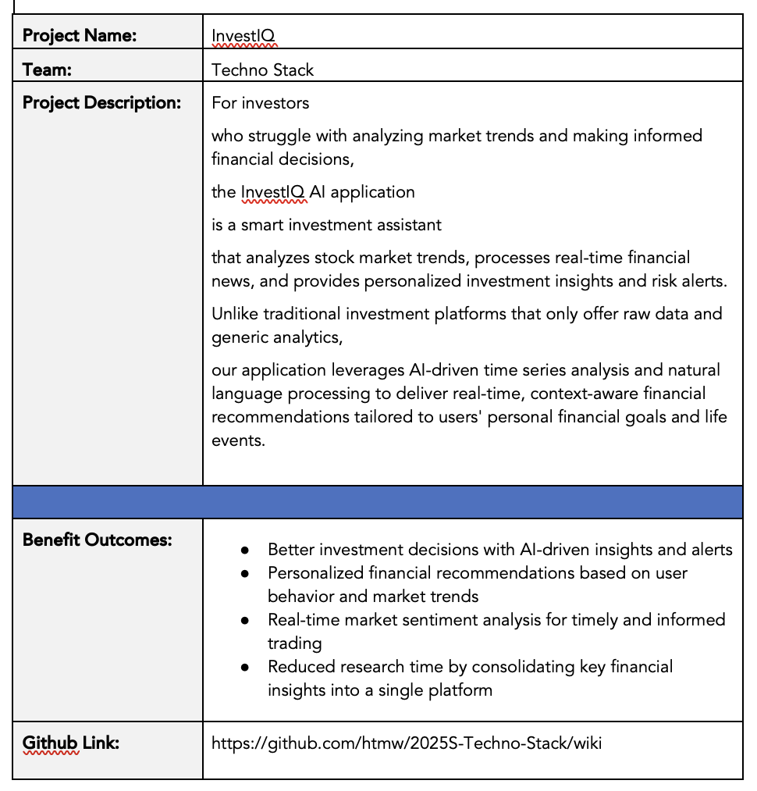
Project description

Slide 8

Persona
Aarav Sharma
Age: 28
Occupation: Software Engineer
Investment Experience: Intermediate
Goals: Simplify his investment decision-making process by utilizing clear, actionable insights from real-time news.
Pain Points: Feels overwhelmed by the vast amount of market data and frustrated by platforms that fail to provide timely news analysis.
Description: Aarav values technology and data-driven insights; he seeks a tool that aggregates real-time news, enabling him to quickly grasp market shifts without the distraction of raw stock data.
Challenges:
Struggles with filtering relevant financial information from the overwhelming amount of market data.
Finds it time-consuming to track news manually and correlate it with market trends.

Slide 9

Persona
Thomas Shelby
Age: 40
Occupation: Corporate Manager
Investment Experience: Beginner to Intermediate
Goals: Achieve steady portfolio growth by staying informed about key market developments through timely news updates.
Pain Points: Finds traditional investment platforms cluttered with irrelevant data and lacking a focused approach to current financial news.
Description: With a busy schedule, Thomas needs a user-friendly platform that provides curated real-time news and actionable insights, enabling him to make confident, long-term financial decisions without continuously monitoring fluctuating stock figures.
Challenges:
Has limited time to stay updated on financial news and market changes.
Prefers risk-averse investments but struggles with identifying safe and promising opportunities.

Slide 10

Persona
Sanjana Reddy
Age: 35
Occupation: Financial Analyst
Investment Experience: Advanced
Goals: Optimize her investment strategy with comprehensive market analysis based on the latest financial news.
Pain Points: Frustrated with generic investment tools that do not integrate timely news, leaving her without the nuanced insights she needs.
Description: Sanjana is analytical and detail-oriented, searching for a sophisticated platform emphasizing real-time news analysis to provide deep insights and tailored recommendations rather than just raw stock data.
Challenges:
Struggles with quickly assessing the sentiment of large volumes of financial news.
It requires advanced analytics but finds that many tools lack deep AI-driven insights.

Slide 11


Technologies - backend
Flask: A lightweight Python framework ideal for building RESTful APIs, easily integrating with machine learning models, and simplifying backend logic.
Node.js: Offers non-blocking, event-driven architecture, making it great for handling real-time operations and concurrent tasks.

Slide 12


Technologies - FRONTEND
Next.js: Offers server-side rendering and static site generation, resulting in fast, SEO-friendly pages and a strong user experience interface.
TypeScript: Improves code quality and maintainability by providing static type checking, which reduces runtime errors.

Slide 13

TECHNOLOGIES - DATABASE
PostgreSQL is a powerful, open-source relational database known for its reliability, scalability, and support for complex queries, ensuring secure and efficient data storage.

Slide 14

TECHNOLOGIES - APIS
Financial News API & Polygon API
These APIs supply real-time financial news and market data, enabling the application to deliver timely and actionable insights without relying on raw stock data.

Slide 15

TECHNOLOGIES – MACHINE LEARNING
PyTorch is selected for its dynamic computation graph and user-friendly interface, making it ideal for developing and training deep learning models used in sentiment analysis and trending forecasting.

Slide 16


TECHNOLOGIES – Hosting & Deployment
Vercel: Perfect for quickly deploying frontend applications with high performance and scalability.
DigitalOcean: Offers dependable and scalable hosting for backend services and the entire application deployment.

Slide 17





TECHNOLOGIES – Development Tools
Visual Studio Code: A versatile code editor featuring extensive extensions and integrated debugging that enhances the developer experience productivity.
Postman: Essential for testing APIs, confirming our endpoints function as expected during development.
Git: To enable version control, enhance collaborative development, and improve code management.
Docker: Used for containerization, ensuring consistency across development, testing, and production environments.
Slack: Facilitates effective team communication and project management.

Slide 18
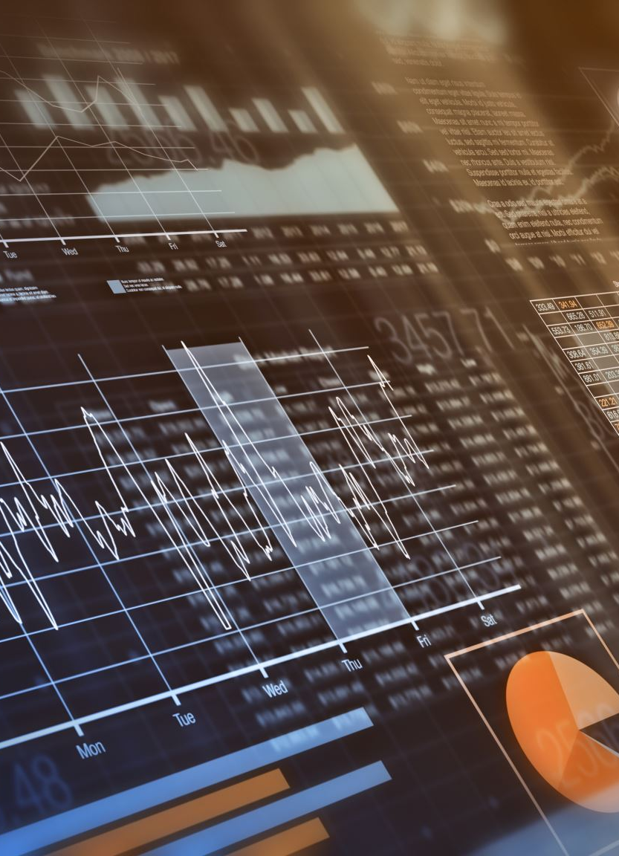
Algorithms - nlp
Our NLP module harnesses cutting-edge technology. The phi model for natural language processing is specifically designed to analyze real-time financial news. This module extracts sentiment and identifies key topics from the latest updates, enabling the application to interpret market sentiment accurately. By processing large volumes of textual data, the phi model provides actionable insights that inform users about market trends and emerging financial narratives, transforming raw news into clear, meaningful investment opportunities guidance.

Slide 19
Algorithms – TIME SERIES
Our Time Series Analysis module examines historical stock market data using advanced deep learning techniques like LSTM and Temporal Fusion Transformers to capture underlying trends and seasonal patterns. This analysis provides essential context that complements the real-time insights derived from our NLP module, ensuring users have a strong understanding of market dynamics. Together, these two modules generate a strong synergy that enables investors to make informed decisions based on current news sentiment and historical market performance.

Slide 20
Project Schedule
23 Jan. – 12 Feb.
Sprint 0 (Jan 23 - Feb 12): Finalize project idea, define roles, select algorithms & technologies, set up Jira, update Wiki, prepare presentation.
13 Feb. – 12 Mar.
Sprint 1 (Feb 13 - Mar 12): Set up backend & database, begin frontend development, integrate APIs, start ML model development, update Wiki.
13 Mar. – 9 Apr.
Sprint 2 (Mar 13 - Apr 9): Complete AI models, integrate with backend, enhance frontend, conduct testing, draft technical paper, update Wiki.
10–30 Apr.
Sprint 3 (Apr 10 - Apr 30): Final testing, optimize performance, complete documentation, ensure working links, finalize presentation & demo.

Slide 21
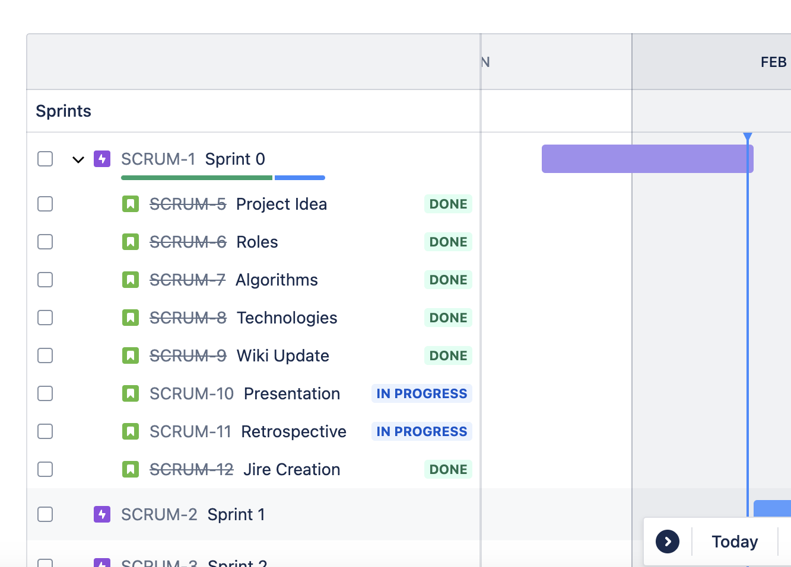
Project Schedule – sPRINT 0

Slide 22
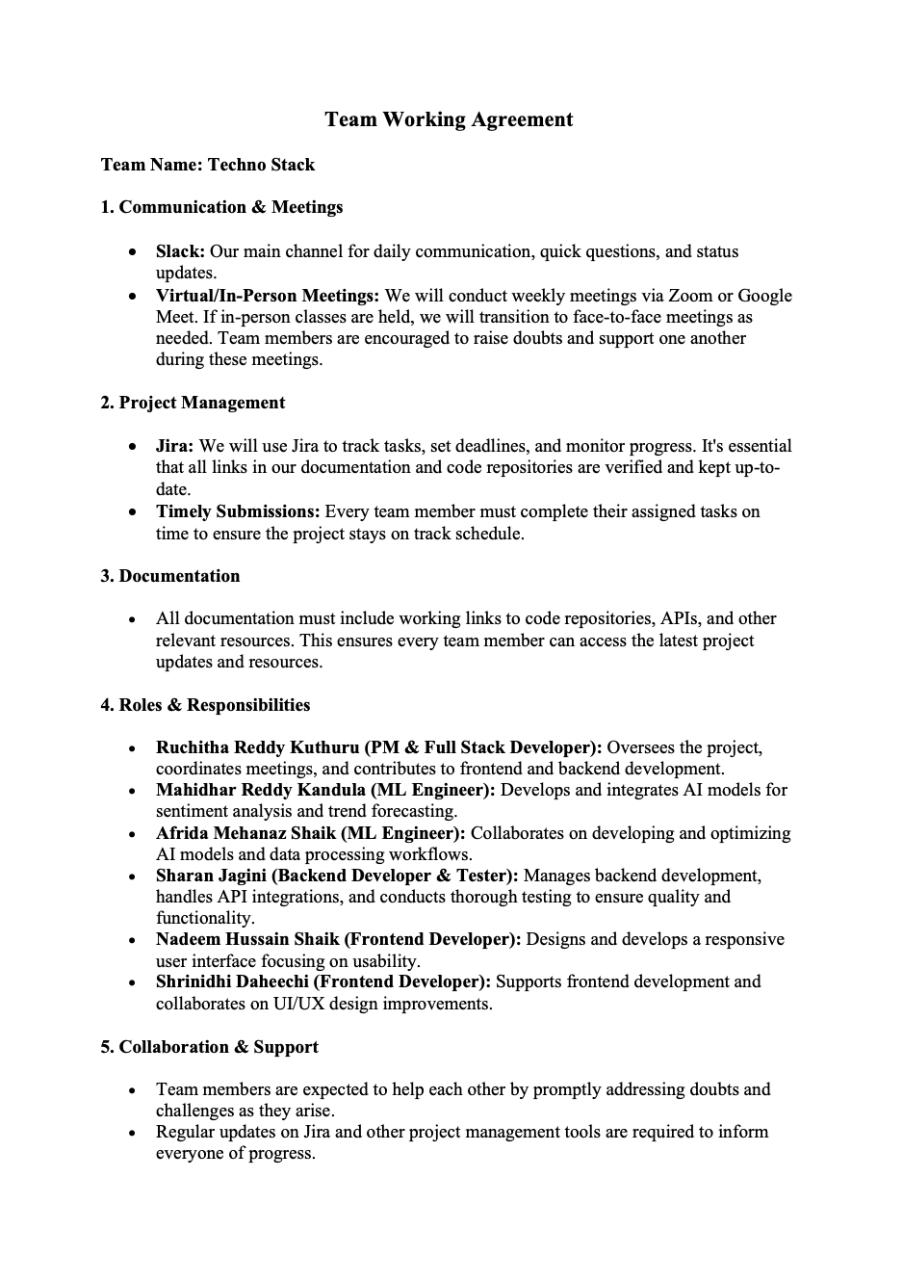

TEAM WORKING AGREEMENT

Slide 23
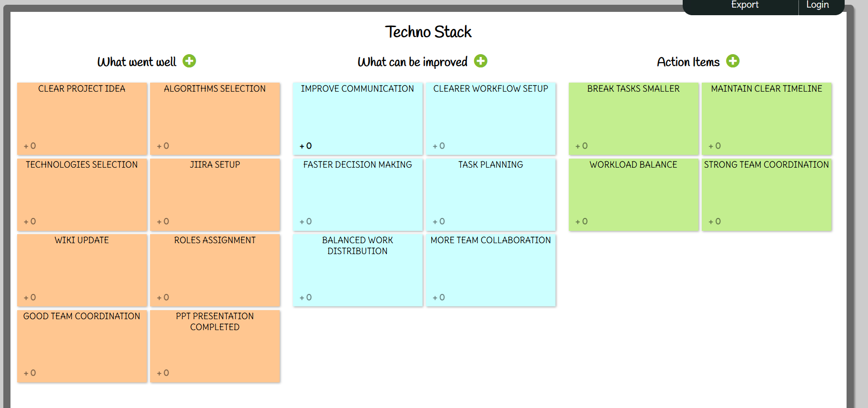
retrospective

Slide 24
Wiki page link
https://github.com/htmw/2025S-Techno-Stack

Slide 25

Thank you

